Slide 1











ESTUBOOK 2ND WEEK
Alex, Quique, Carles, Fran, Xavier

Slide 2

INDEX
Scene Builder
Java
HTML and CSS
JavaScript

Slide 3
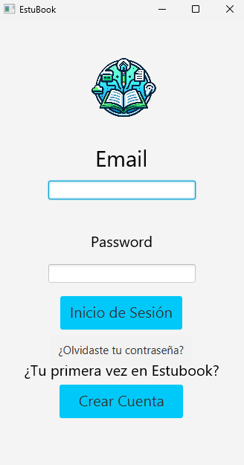
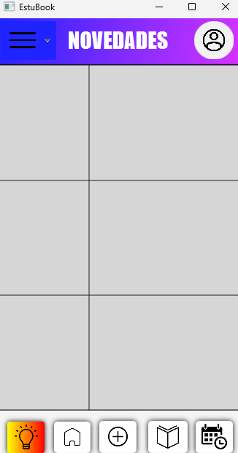

SCENE BUILDER
We finished all we could in scene builder and made the aplication more stylish and attractive

Slide 4

JAVA
We did all we could and we spent a lot of time buiding all the code in java for the aplication to work

Slide 5

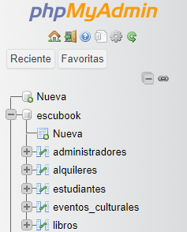
HTML AND CSS
This week we made a photo carousel in html and merged the html with our Database, this way we can log in with the users we have in our database

Slide 6

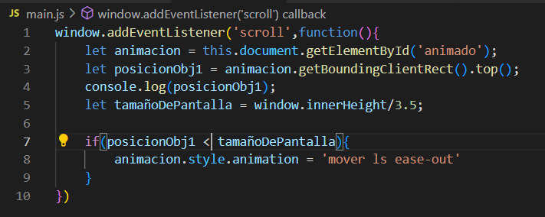

JAVASCRIPT
Thanks to JavaScript, we have implemented the logo to move on the web page.

Slide 7
THANK YOU
for your time!

